Slide 1
IR Viewer Retail
Design Document

Slide 2
General Information
We will create an IR viewer with customer defined constraints. This solution will be developed using Visual Studio 2008, C# (same as DG). The interface will use either the SDK or Web Services (planning on WS, use SDK only if WS fails to meet customer driven requirements for performance or capabilities). The interface will have a tab in WebFEP portal system containing the viewer. The screen will be broken into two areas. One for dual purpose search criteria (Policy# and/or Insured Name) or document display. The other for the tree view of File(policy)/Folder/Document/Page results. The program will not incorporate any Agent security, so all agents will be able to have read access to documents that are displayed. The viewer will allow the user to navigate from the file level to the page level. The interface will allow all doc types to be returned. Below are a few diagrams that can show a possible layout of the viewer.

Slide 3
Assumptions
MS Visual Studio 2008, using C# programming language
IR SDK or Web Services, 4.0
No agent level security
Treeview of policies down to the page level
Return all doc types, no annotations
All IR documents/pages are read only
The search criteria can include one or all of the options
Policy number
Insured Name

Slide 4
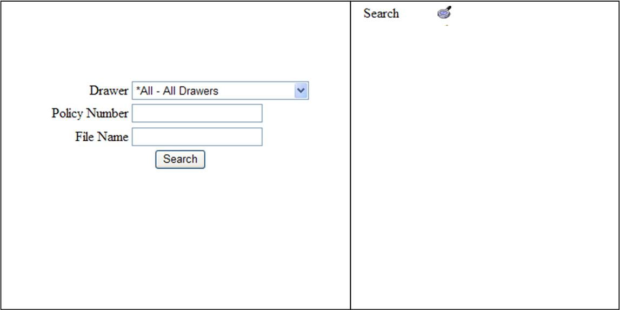
IR Viewer Retail Interface
Initial Screen
The search/doc viewer screen will open in the left window, with the tree in the right window. The search button in the right window will return to the search screen in the left window.

Slide 5
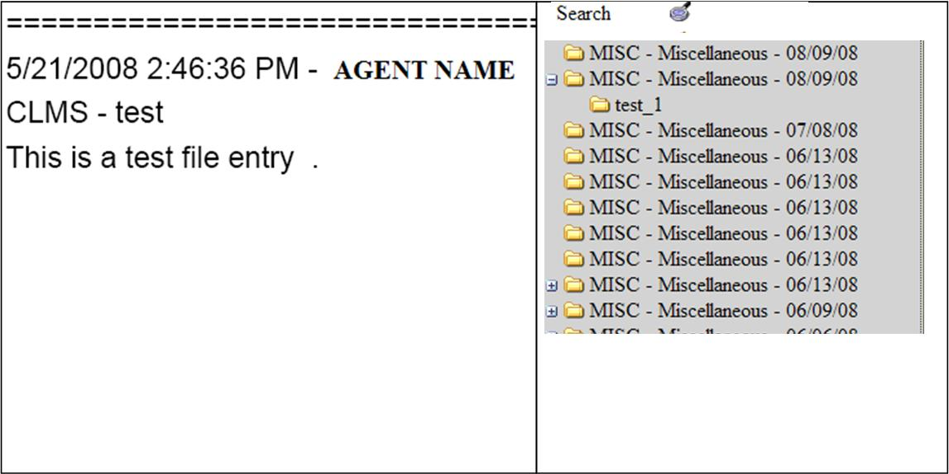
IR Viewer Retail Interface
Search Results
On the left side the document is return as a PDF image in the clients Adobe Reader plugin. On the right is a list of documents that are available and match the search criteria.

